Slide 1
Architecture of Enterprise Applications 1
Overview of Enterprise Applications
Haopeng Chen
REliable, INtelligent and Scalable Systems Group (REINS)
Shanghai Jiao Tong University
Shanghai, China
http://reins.se.sjtu.edu.cn/~chenhp
e-mail: chen-hp@sjtu.edu.cn

Slide 2
Contents and Objectives
Contents
  Architecture
  Scope
Objectives
  能够根据应用系统的规模，确定适合的技术路线，从单机部署到分布式集群部署，再到微服务架构和云部署
  能够根据系统需求，设计并实现由合理的有状态服务与无状态服务构成服务层

Slide 3
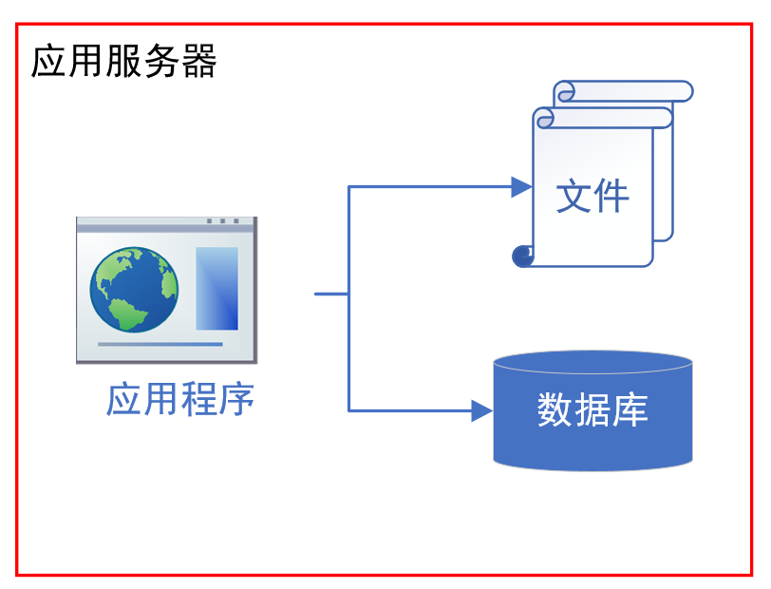
Architecture of Java Web Application

Slide 4
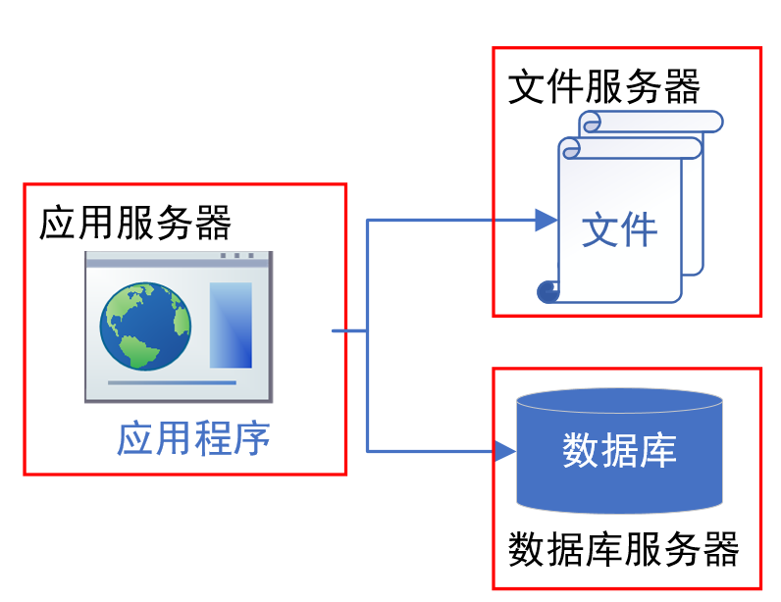
Architecture of Java Web Application

Slide 5
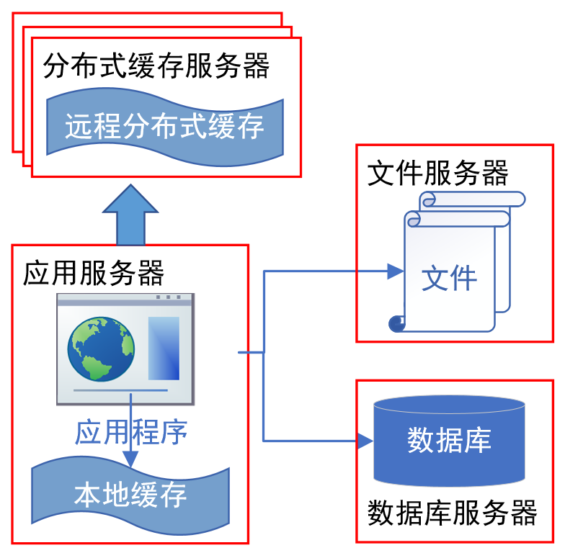
Architecture of Java Web Application

Slide 6
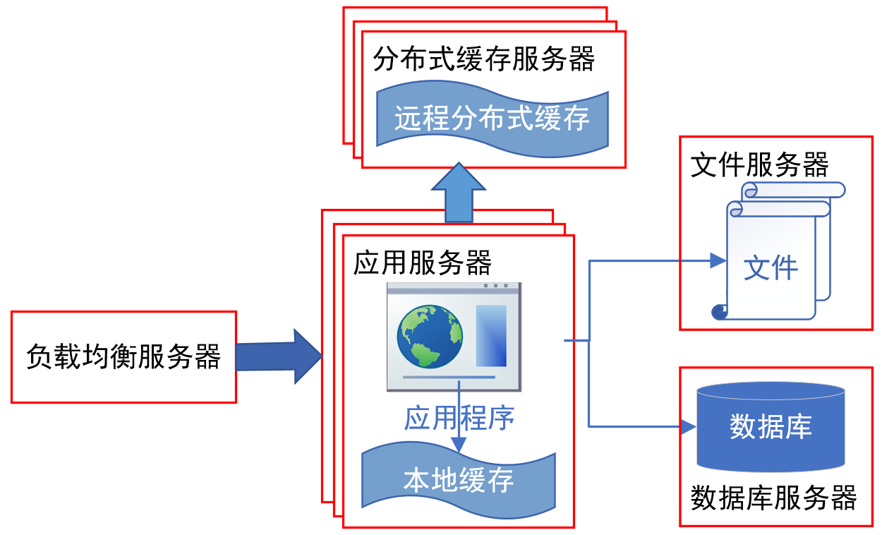
Architecture of Java Web Application

Slide 7
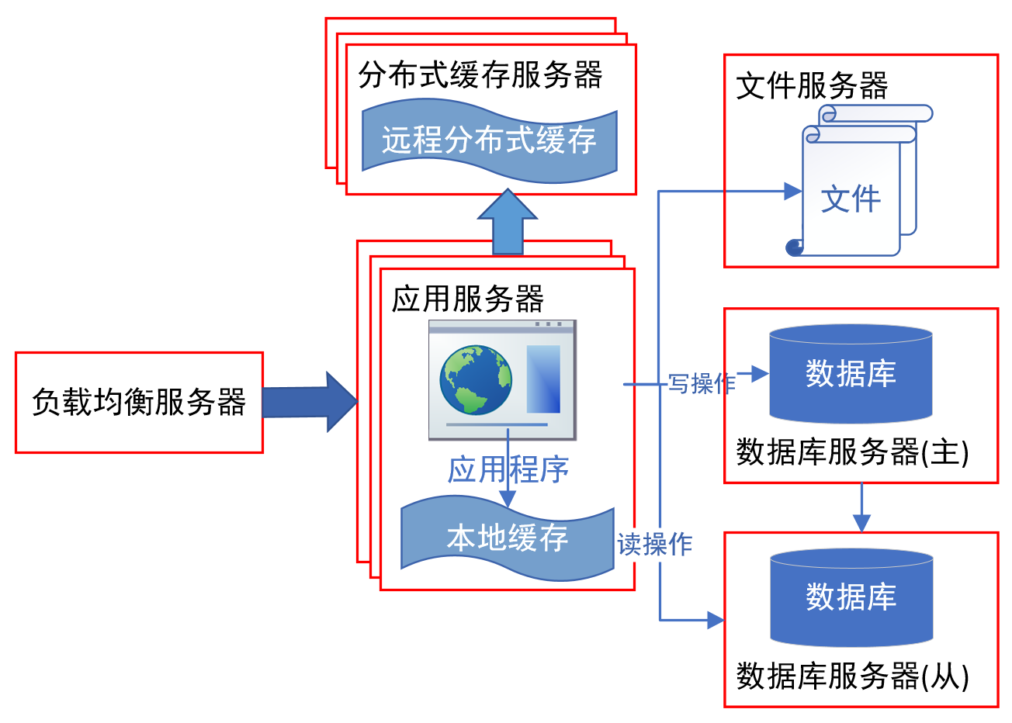
Architecture of Java Web Application

Slide 8
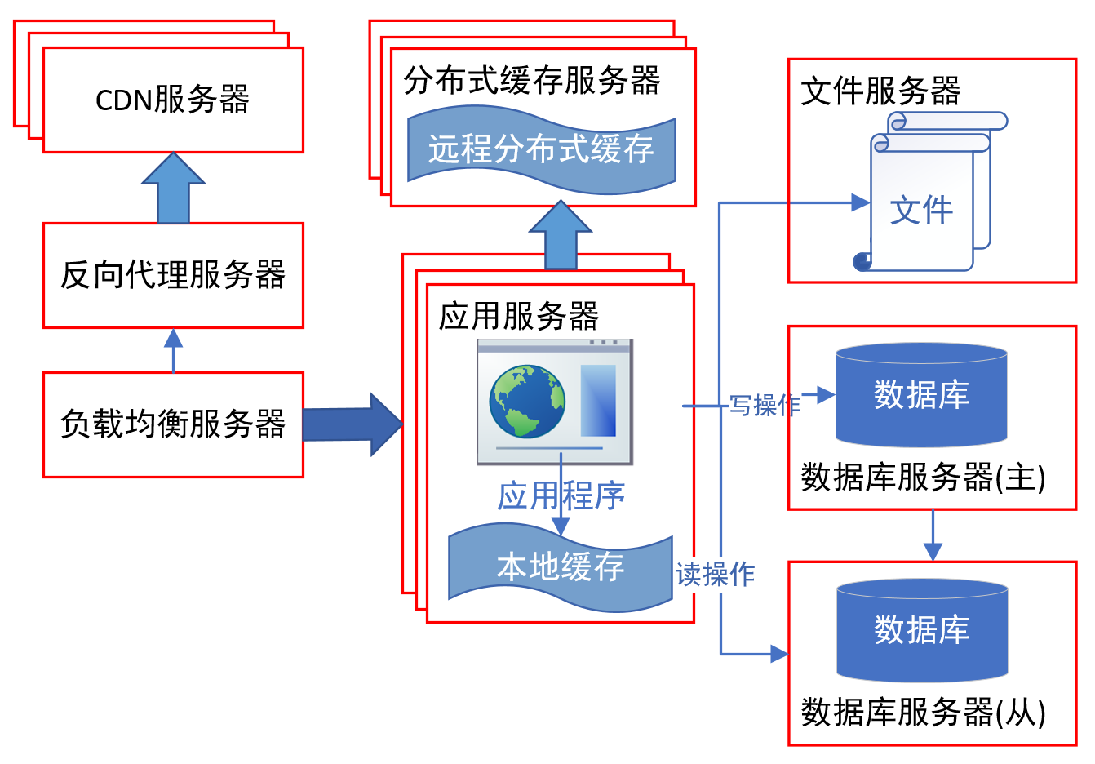
Architecture of Java Web Application

Slide 9
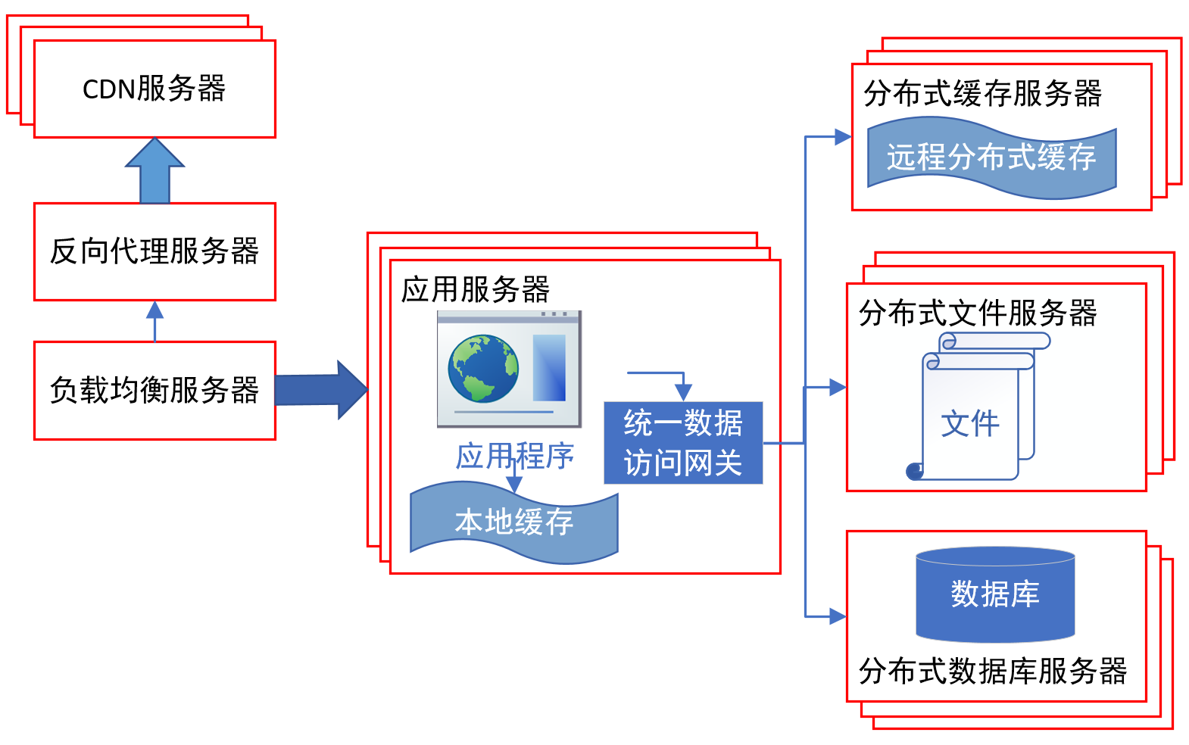
Architecture of Java Web Application

Slide 10
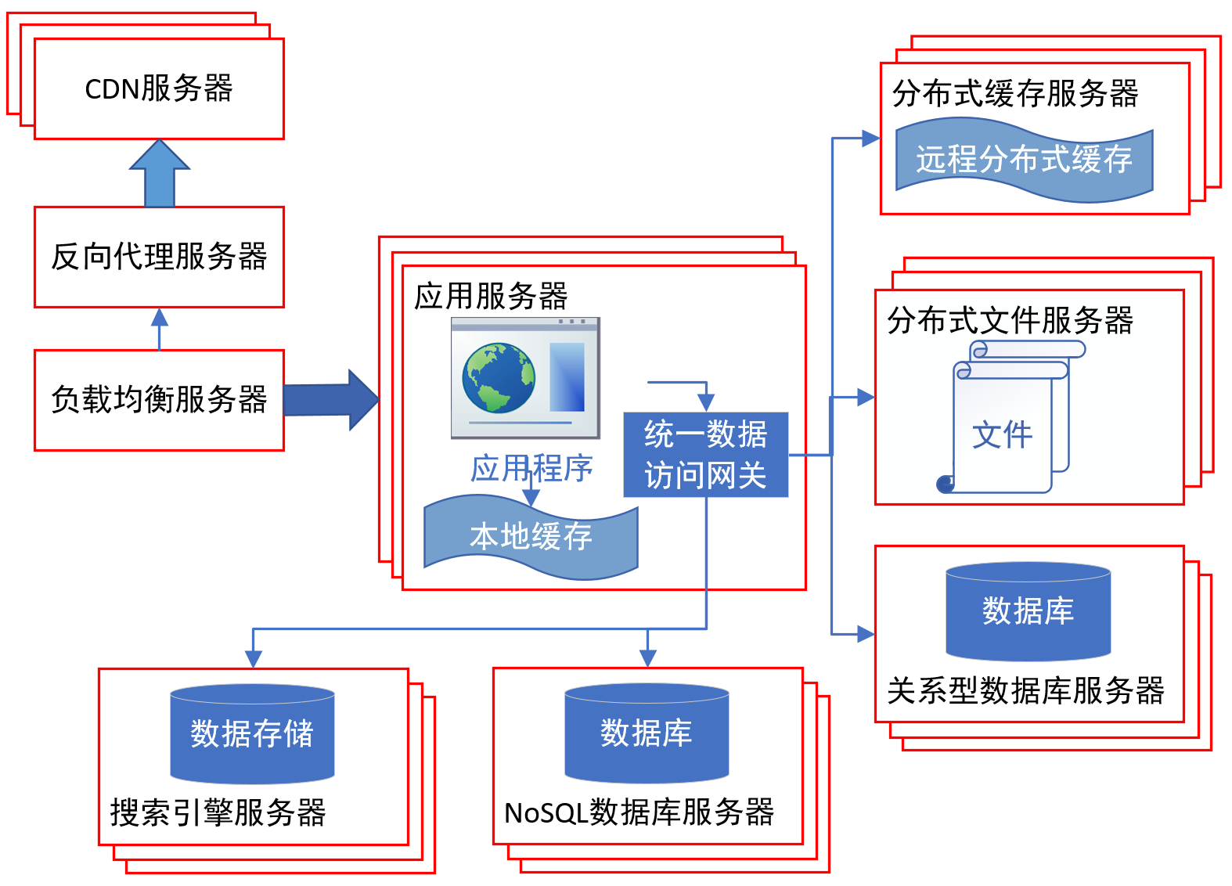
Architecture of Java Web Application

Slide 11
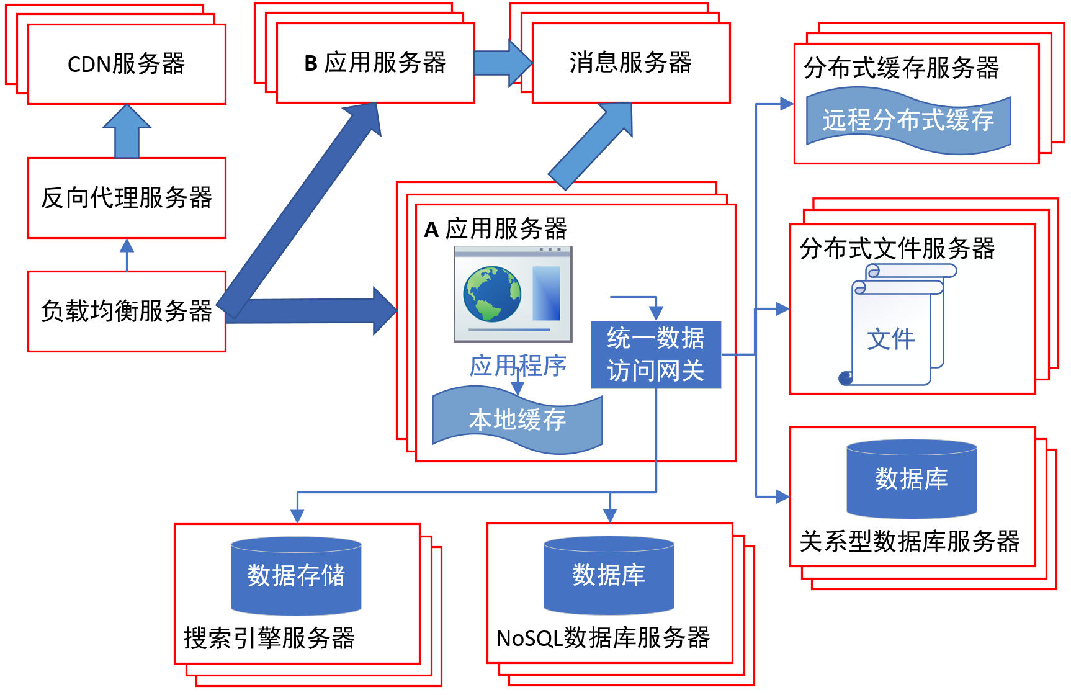
Architecture of Java Web Application

Slide 12
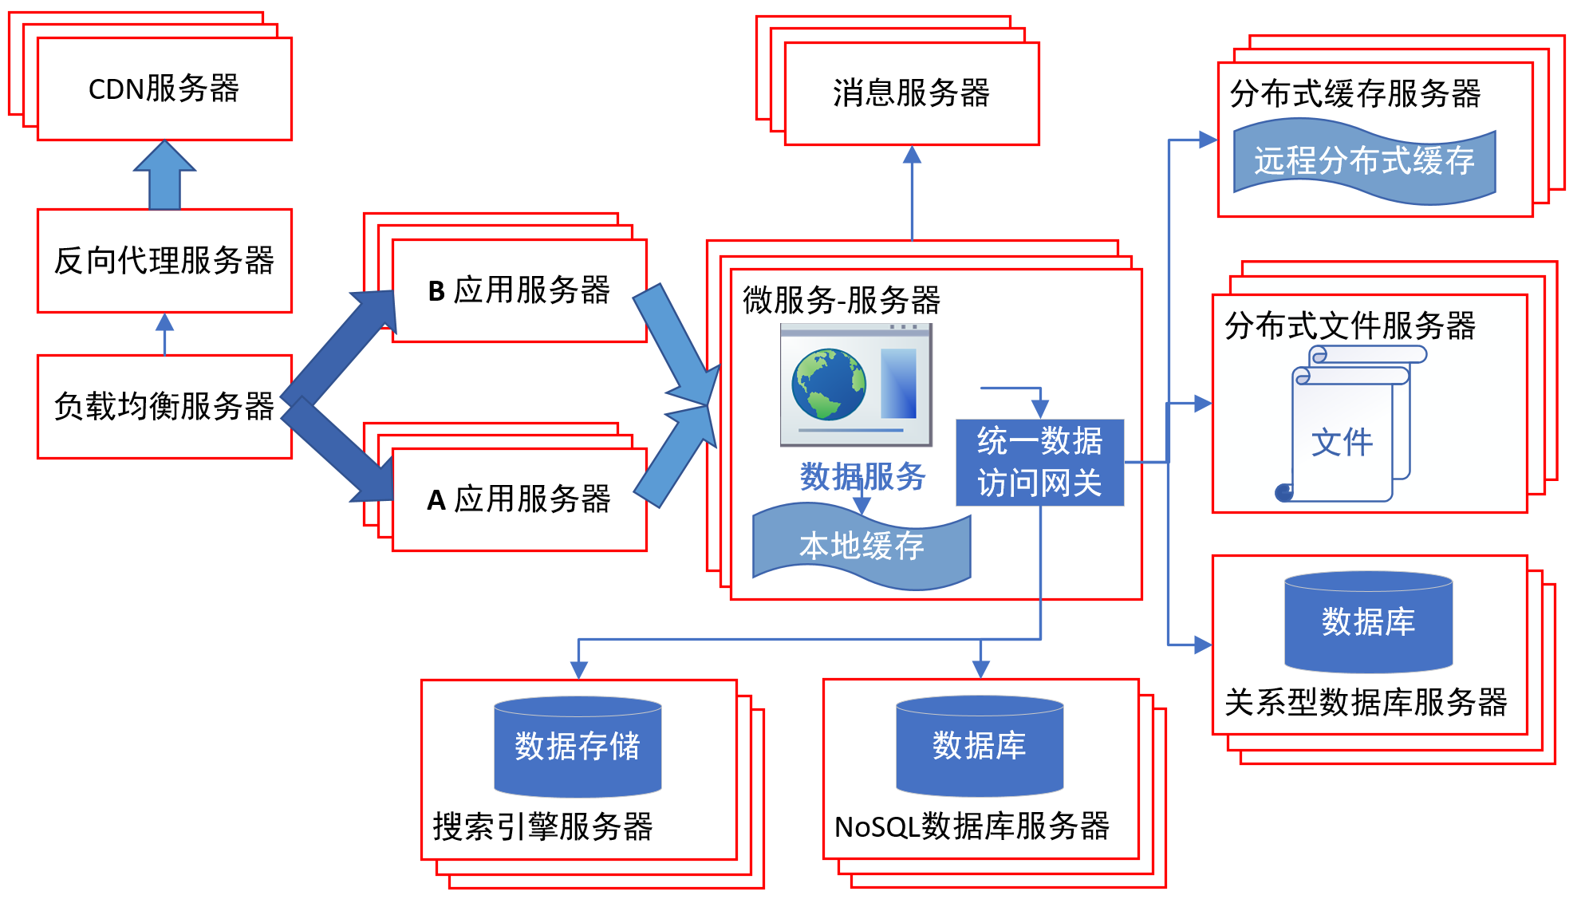
Architecture of Java Web Application

Slide 13
Architecture of Enterprise Applications 1
Stateful and Stateless Services
Haopeng Chen
REliable, INtelligent and Scalable Systems Group (REINS)
Shanghai Jiao Tong University
Shanghai, China
http://reins.se.sjtu.edu.cn/~chenhp
e-mail: chen-hp@sjtu.edu.cn

Slide 14
Recall: HTTP session state
HTTP is a stateless protocol
  A stateless protocol does not require the HTTP server to retain information or status about each user for the duration of multiple requests.
  from: https://www.openhome.cc/Gossip/ServletJSP/BehindHttpSession.html

Slide 15
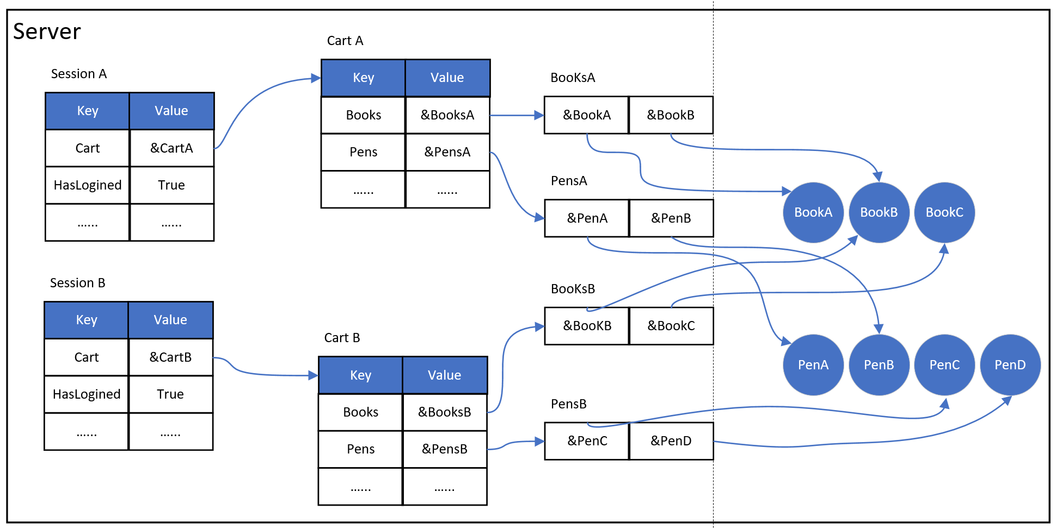
Recall: HTTP session state
HTTP is a stateless protocol

Slide 16
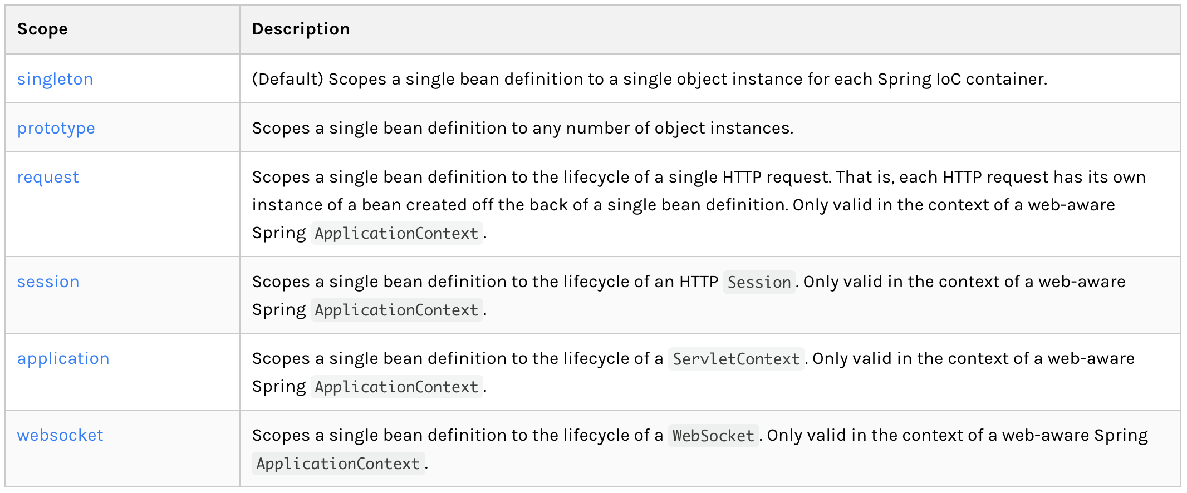
Spring Bean Scopes
What’s the meaning of scope?

Slide 17
Scope
Singleton : Stateless

Slide 18
Scope
Prototype : Stateful

Slide 19
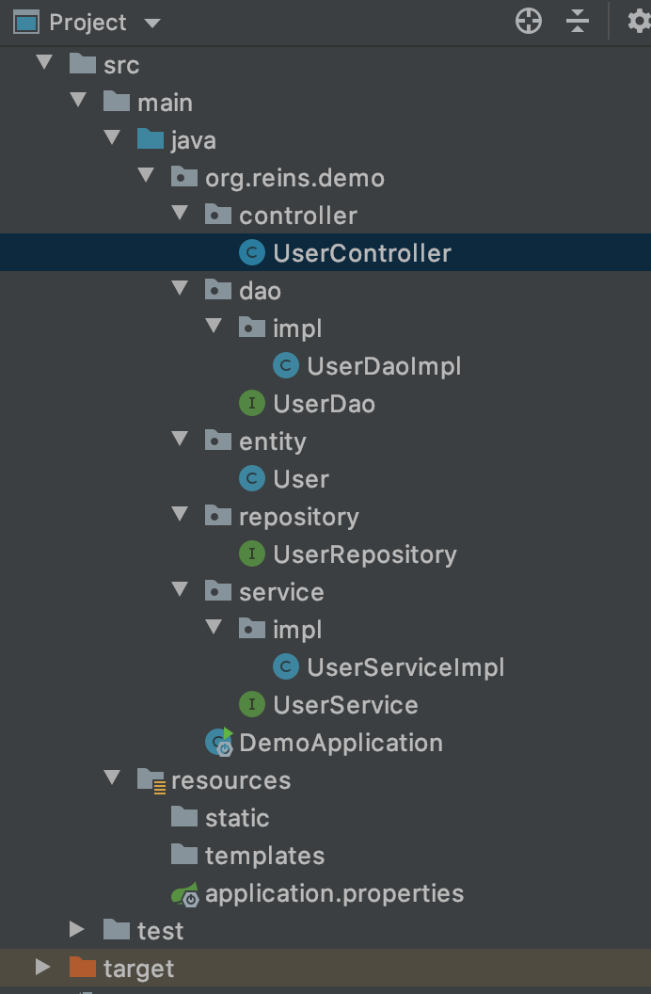
Default Scope - singleton
UserController.java
@RestController
public class UserController {
@Autowired
private UserService userService;
@GetMapping(value = "/findUser/{id}")
public User findOne(@PathVariable("id") String id) {
System.out.println(userService);
return userService.findUserById(Integer.valueOf(id));
};
}
UserServiceImpl.java
@Service
public class UserServiceImpl implements UserService {
@Autowired
private UserDao userDao;
@Override
public User findUserById(Integer id) {
return userDao.findOne(id);
}
}

Slide 20
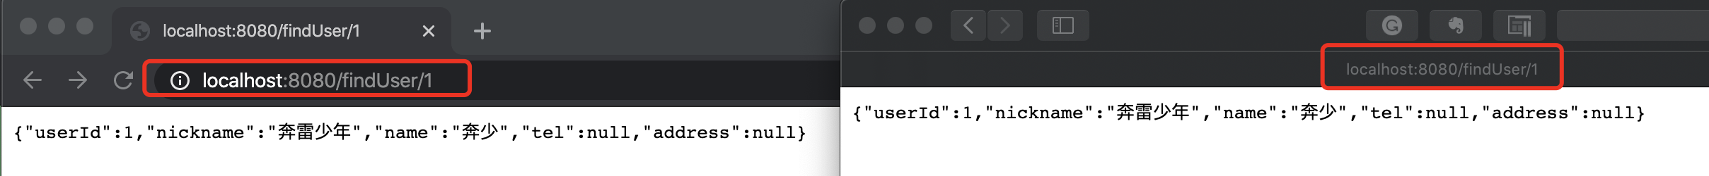
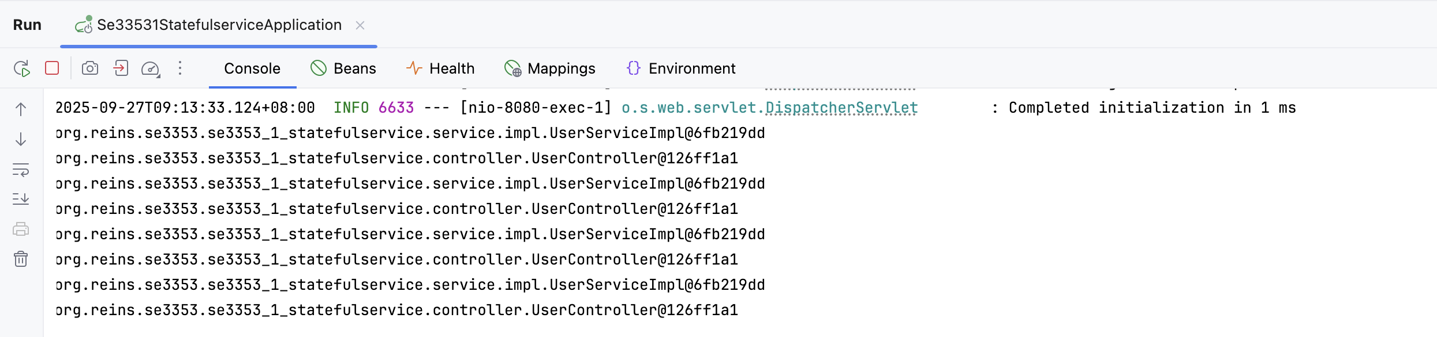
Default Scope - singleton
Single Service instance

Slide 21
Scope - prototype
UserController.java
@RestController
@Scope("prototype")
public class UserController {
@Autowired
private UserService userService;
@GetMapping(value = "/findUser/{id}")
public User findOne(@PathVariable("id") String id) {
System.out.println(userService);
return userService.findUserById(Integer.valueOf(id));
};
}
prototype
UserServiceImpl.java
@Service
@Scope("prototype")
public class UserServiceImpl implements UserService {
@Autowired
private UserDao userDao;
@Override
public User findUserById(Integer id) {
return userDao.findOne(id);
}
}
prototype

Slide 22
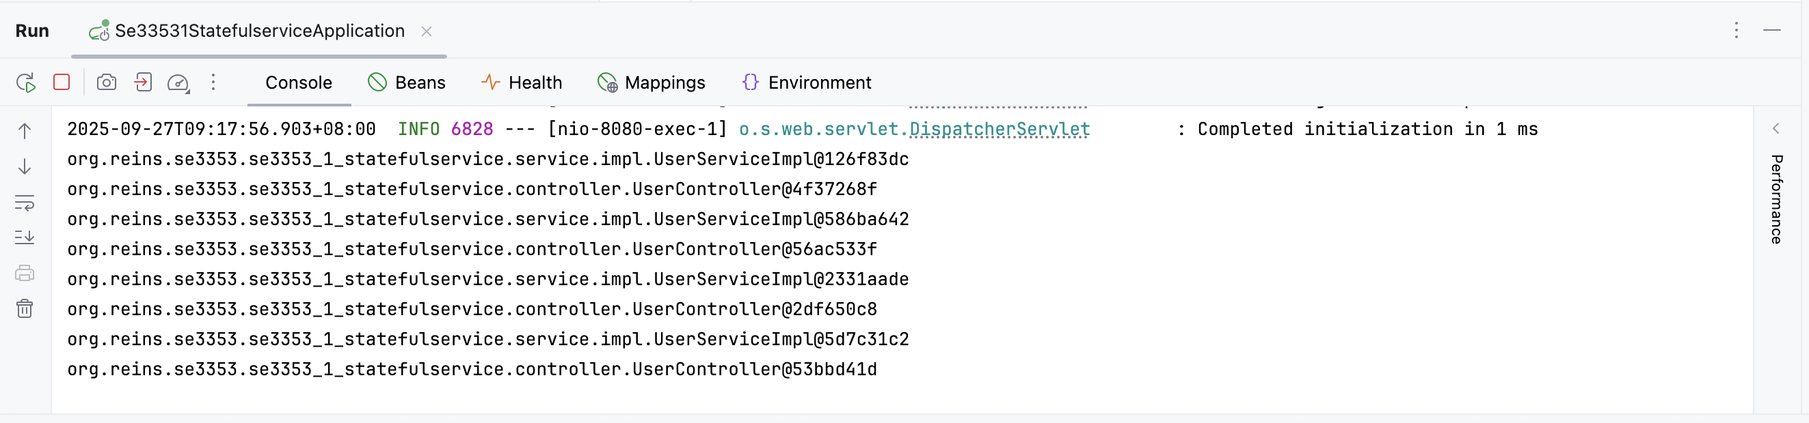
Scope - prototype
Now different. But not good!

Slide 23
Scope - prototype
UserController.java
@RestController
public class UserController {
@Autowired
WebApplicationContext applicationContext;
@GetMapping(value = "/findUser/{id}")
public User findOne(@PathVariable("id") String id) {
UserService userService = applicationContext.getBean(UserService.class);
System.out.println(userService);
return userService.findUserById(Integer.valueOf(id));
};
}
WebApplicationContext
UserService
UserServiceImpl.java
@Service
@Scope("prototype")
public class UserServiceImpl implements UserService {
@Autowired
private UserDao userDao;
@Override
public User findUserById(Integer id) {
return userDao.findOne(id);
}
}
prototype

Slide 24
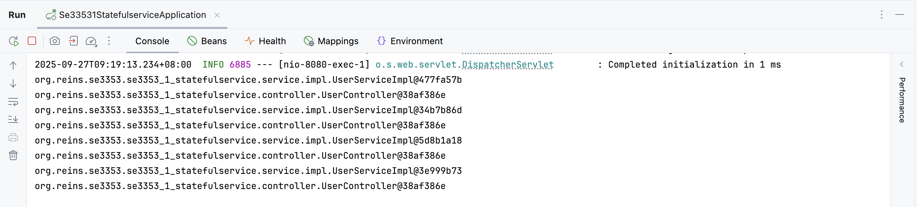
Scope - prototype
Now different. Why is this solution better?

Slide 25
Scope - session
UserController.java
@RestController
public class UserController {
@Autowired
WebApplicationContext applicationContext;
@GetMapping(value = "/findUser/{id}")
public User findOne(@PathVariable("id") String id) {
UserService userService = applicationContext.getBean(UserService.class);
System.out.println(userService);
return userService.findUserById(Integer.valueOf(id));
};
}
WebApplicationContext
UserService
UserServiceImpl.java
@Service
@Scope(”session")
public class UserServiceImpl implements UserService {
@Autowired
private UserDao userDao;
@Override
public User findUserById(Integer id) {
return userDao.findOne(id);
}
}
session

Slide 26
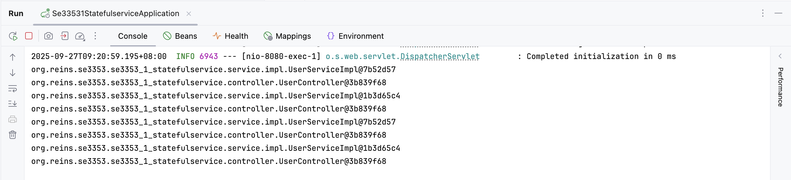
Scope - session
Two Service instances

Slide 27
Scope - session
UserController.java
@RestController
@Scope(”session")
public class UserController {
@Autowired
WebApplicationContext applicationContext;
@GetMapping(value = "/findUser/{id}")
public User findOne(@PathVariable("id") String id) {
UserService userService = applicationContext.getBean(UserService.class);
System.out.println(userService);
System.out.println(this);
return userService.findUserById(Integer.valueOf(id));
};
}
session
WebApplicationContext
UserService
this
UserServiceImpl.java
@Service
@Scope(”prototype")
public class UserServiceImpl implements UserService {
@Autowired
private UserDao userDao;
@Override
public User findUserById(Integer id) {
return userDao.findOne(id);
}
}
prototype

Slide 28

Scope - session
Two Controller instances
Four Service instances

Slide 29
Scope - session
UserController.java
@RestController
@Scope(”session")
public class UserController {
@Autowired
WebApplicationContext applicationContext;
@GetMapping(value = "/findUser/{id}")
public User findOne(@PathVariable("id") String id) {
UserService userService = applicationContext.getBean(UserService.class);
System.out.println(userService);
System.out.println(this);
return userService.findUserById(Integer.valueOf(id));
};
}
session
WebApplicationContext
UserService
this
UserServiceImpl.java
@Service
@Scope(”session")
public class UserServiceImpl implements UserService {
@Autowired
private UserDao userDao;
@Override
public User findUserById(Integer id) {
return userDao.findOne(id);
}
}
session

Slide 30
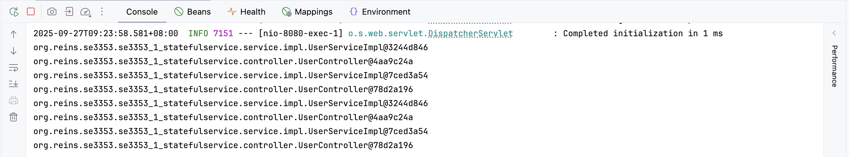
Scope - session
Two Controller instances
Two Service instances

Slide 31
Scope - session
UserController.java
@RestController
@Scope(”prototype")
public class UserController {
@Autowired
WebApplicationContext applicationContext;
@GetMapping(value = "/findUser/{id}")
public User findOne(@PathVariable("id") String id) {
UserService userService = applicationContext.getBean(UserService.class);
System.out.println(userService);
System.out.println(this);
return userService.findUserById(Integer.valueOf(id));
};
}
prototype
WebApplicationContext
UserService
this
UserServiceImpl.java
@Service
@Scope(”session")
public class UserServiceImpl implements UserService {
@Autowired
private UserDao userDao;
@Override
public User findUserById(Integer id) {
return userDao.findOne(id);
}
}
session

Slide 32
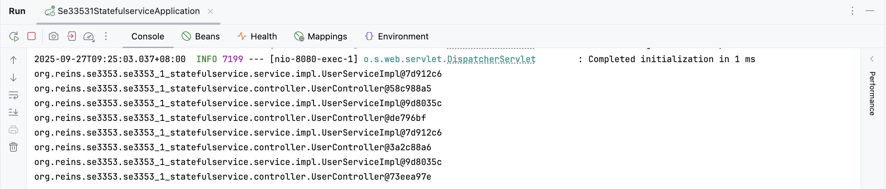
Scope - session
Four Controller instances
Two Service instances

Slide 33
Summary
2 Browsers(2 Sessions), 4 Requests( 2 times / session)
How should we design the scopes of Beans?
 |  | Controller
 |  | Prototype | session
Service | prototype | 4 service instances 4 controller instances | 4 service instances 2 controller instances
 | session | 2 service instances 4 controller instances | 2 service instances 2 controller instances

Slide 34
Scoped Proxy
MyController.java
@RestController
public class MyController {
@Autowired
private RequestContext requestContext;
@GetMapping("/demo")
public String demo() throws InterruptedException {
Thread.sleep(100);
return "Trace ID: " + requestContext.getTraceId();
}
}
Singleton Scoped Controller
Request/Session Scoped Bean

Slide 35
Scoped Proxy
RequestContext.java
@Component
@Scope(value = WebApplicationContext.SCOPE_REQUEST,
proxyMode = ScopedProxyMode.TARGET_CLASS)
public class RequestContext {
private final String traceId = UUID.randomUUID().toString();
public String getTraceId() { return traceId; }
}
Spring 提供了解决此问题的机制 —— 通过代理来延迟注入 request-scoped Bean，即用一个代理对象占位，等请求来了再实际生成 Bean 实例。

Slide 36
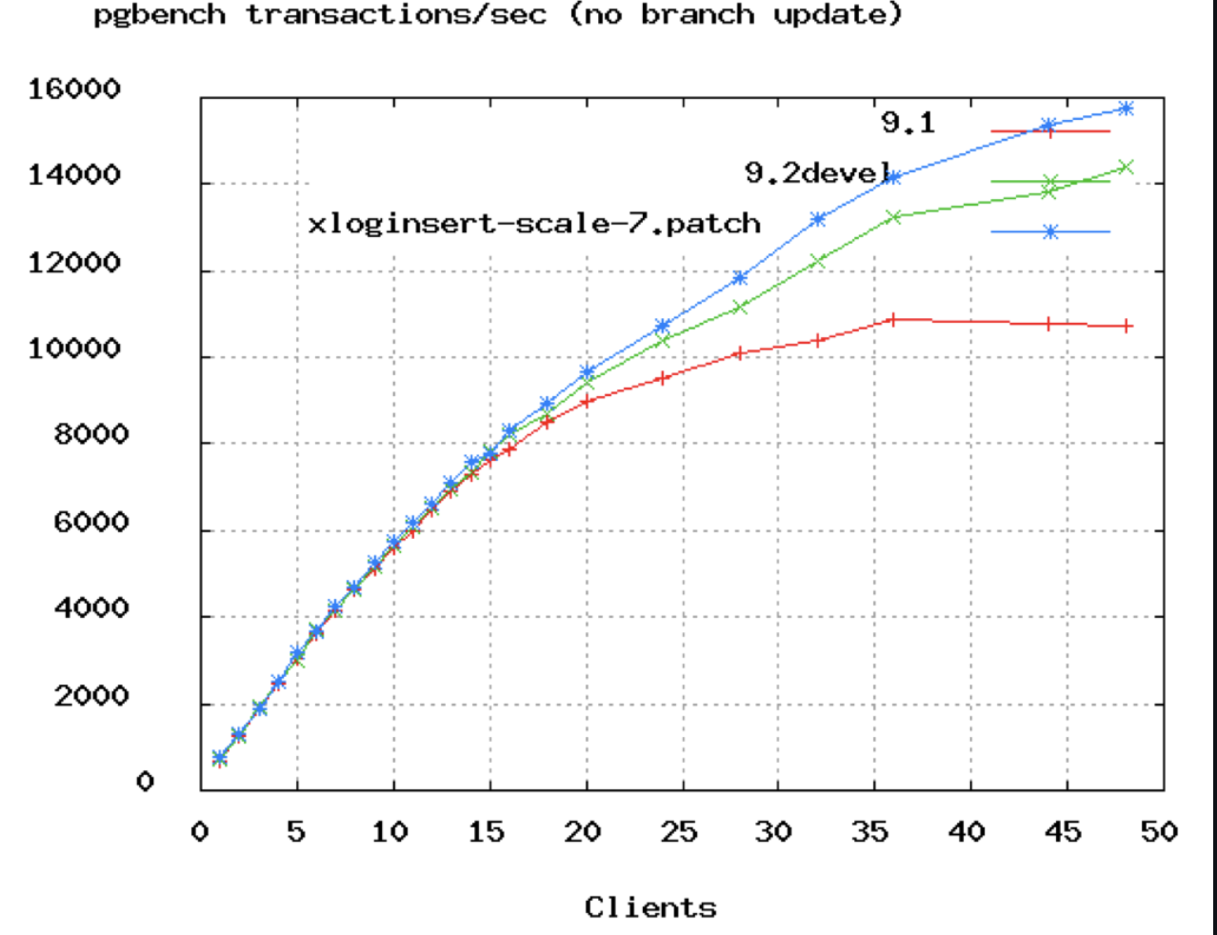
Database Connection Pool Size
https://github.com/brettwooldridge/HikariCP/wiki/About-Pool-Sizing
https://www.youtube.com/watch?v=_C77sBcAtSQ
connections =
((core_count * 2) + effective_spindle_count)
Axiom: You want a small pool, saturated with threads waiting for connections.

Slide 37
References
Web开发的发展史
  https://linux.cn/article-3166-1.html
The IoC Container- Bean Scopes
  https://docs.spring.io/spring/docs/5.2.3.RELEASE/spring-framework-reference/core.html#beans-factory-scopes
Quick Guide to Spring Bean Scopes
  https://www.baeldung.com/spring-bean-scopes
Spring注解中@Scope 的使用解说
  https://blog.csdn.net/cuichunchi/article/details/79170240

Slide 38

Thank You!

